Slide 1
Frontend vs BackEnd vs Fullstack
The Difference

Slide 2
Front-end
Front-end development focuses on the client-facing aspects of a website or web application. This includes designing and optimizing the user interface, working on important visual aspects of web pages, and taking care of any website debugging issues. Front-end code and front-end languages help developers implement complex and effective web design. In order to become a successful front-end developer, there are certain languages, tools, and frameworks that you need to become familiar with.

Slide 3
Framework
Front-end frameworks give us a prepared template or structure to use for our JavaScript code. They group together JavaScript libraries to make the coding process more efficient. There are many different frameworks to choose from. Popular frameworks include:
AngularJS
Vue.js
React
Backbone
Ember

Slide 4
Back-end
Back-end development focuses on the server-side aspects of a website or web application. This type of development is concerned with website architecture, scripting, and communication with databases. Back-end code enables the communication between browsers and information from databases. Back-end developers focus on how a website functions, which means they might work with APIs, code that interacts with databases, libraries, data architecture, and more. Back-end development works together with front-end development to provide users with a functional and interactive experience.

Slide 5

Example

Slide 6
Fullstack
Full-stack development combines front-end and back-end development. This means that full-stack developers can create entire websites and web applications. They work on client-side, server-side, debugging, and database work. Full-stack web developers can program browsers, servers, and databases.
As a full-stack developer, you need to have solid experience with front-end and back-end development tools. Full-stack developers work with web development stacks. These stacks include all of the essential parts of a modern web application or website, including front-end tools, back-end tools, and the database. Some stacks include application frameworks or state management tools.

Slide 7
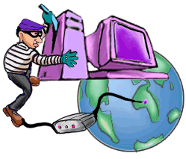
OWASP’s Top 10 List
Injection Flaws
    SQL Injection, XPATH Injection, etc
Cross-Site Scripting (XSS)
Broken Authentication and Session Management
Insecure Direct Object Reference
Cross Site Request Forgery (CSRF)
Security Misconfiguration
Insecure Cryptographic Storage
Failure to Restrict URL Access
Insufficient Transport Layer Protection
Unvalidated Redirects and Forwards
From OWASP Top 10: The Ten Most Critical Web Application Security Vulnerabilities

Slide 8
What We’re Covering
Cross-Site Scripting (XSS)
Cross-Site Request Forgery (CSRF)
Insecure Direct Object Reference
Injection Flaws
    SQL Injection, XPATH Injection, etc
Broken Authentication and Session Management
Failure to Restrict URL Access
Insecure Cryptographic Storage

Slide 9
Cross-Site Scripting (XSS) Attacks
Malicious code that can change the look and function of a legitimate web application
  Originates from old phishing attacks but less obvious and more dangerous to the user/victim
  More widespread now because of move to more rich Internet applications using dynamic content and JavaScript and the latest AJAX trend
My favorite XSS resource
  OWASP Cross-site Scripting (XSS)

Slide 10
Websites XSS’d
A hacker was able to insert JavaScript code into the Obama community blog section
  The JavaScript would redirect the users to the Hillary Clinton website
  YouTube Demonstration
  Read about it on ChannelWeb
Websites from FBI.gov, CNN.com, Time.com, Ebay, Yahoo, Apple computer, Microsoft, Zdnet, Wired, and Newsbytes have all had XSS bugs.

Slide 11
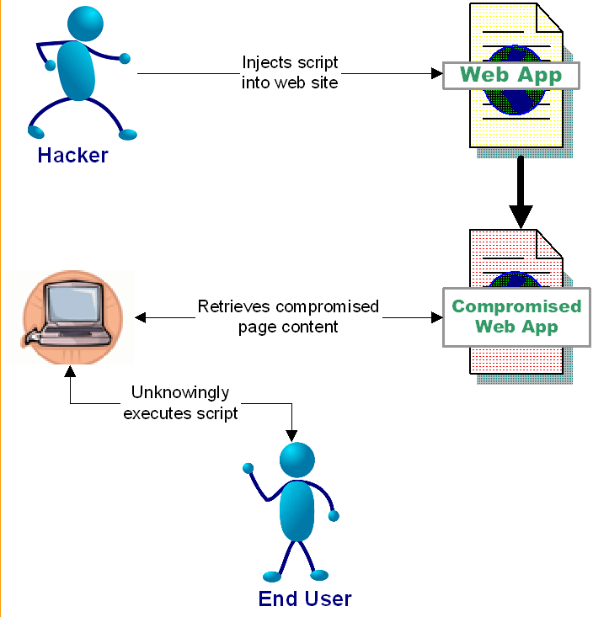
Cross-Site Scripting (XSS) Attacks

Slide 12
The Impact of XSS
Data residing on the web page can be sent anywhere in the world
  Including cookies!
Facilitates many other types of attacks
  Cross-Site Request Forgery (CSRF), Session Attacks (more later)
Your site’s behavior can be hijacked

Slide 13
Our first demo…
Stored XSS Attack

Slide 14
Preventing XSS
Escape all user input when it is displayed
  Escaping converts the output to harmless html entities
    <script> becomes &lt;script&gt;
    but still displayed as <script>
  Methods:
    OWASP ESAPI
    Java Standard Tag Library (JSTL) <c:out/>
OWASP XSS Prevention Cheat Sheet

Slide 15
Preventing XSS - Continued
Ensure your filter uses a white list approach
  Filters based on blacklisting have historically been flawed
    E.g. PHP, Ruby on Rails sanitize method
  New encoding schemes can easily bypass filters that use a blacklist approach
Do not accept and reflect unsolicited input
  Reflecting every parameter for confirmation pages
  Printing out the session/request parameters in error pages
Great XSS Test Fixture: http://ha.ckers.org/xss.html

Slide 16

This Presentation's Re-ordered List
Cross-Site Scripting (XSS)
Cross-Site Request Forgery (CSRF)
Insecure Direct Object Reference
Injection Flaws
    SQL Injection, XPATH Injection, etc
Broken Authentication and Session Management
Failure to Restrict URL Access
Insecure Cryptographic Storage

Slide 17
Cross Site Request Forgery (CSRF)
From http://www.owasp.org/index.php/Top_10_2010-Main:
“A CSRF attack forces a logged-on victim's browser to send a pre-authenticated request to a vulnerable web application, which then forces the victim's browser to perform a hostile action to the benefit of the attacker. CSRF can be as powerful as the web application that it attacks.

Slide 18
Cross Site Request Forgery (CSRF)
Occurs when an authenticated user unknowingly initiates a request
The request is handled as if it were intentional
  Usually happens without the user being aware!
CSRF attacks are difficult to track
  Commands are executed in the context of the victim
  The request comes from the users IP address so it is difficult to hunt down the hacker
The hacker is essentially given all of the user’s privileges
XSS facilitates CSRF via “Link Injection”

Slide 19
CSRF Example
A hacker posts to a message board containing an image tag
  <img src= “http://yourbank.com/transfer? to_account=my_account_number&amount=all_of_your_money>
An unsuspecting user logs into yourbank.com and authenticates
The user then visits said message board
A request is issued from the victim’s browser to the bank’s website
The bank’s website transfers the user’s money to the hacker’s account

Slide 20
CSRF In the Real World
Netflix vulnerabilities allowed attackers to change the shipping addresses, email address, password, and movie queues
Novell GroupWise WebAccess was found to contain a CSRF (and XSS) vulnerability that allowed an attacker to receive copies of any compromised email account
Sun’s IdM allowed hackers to change the passwords of admin accounts

Slide 21
Cross Site Request
Forgery Demo
CRSF Demo

Slide 22
Solution
Add a secondary authentication mechanism
  Such as an impossible to guess token
Require a confirmation page before executing potentially dangerous actions
Eliminate XSS vulnerabilities
Use POST as your form action and only accept POST requests on the server for sensitive data !
  Incoming CSRF requests will fail since the parameter is in the URL and not the post body
You can protect yourself with RequestPolicy (Firefox extension)

Slide 23
This Presentation's Re-ordered List
Cross-Site Scripting (XSS)
Cross-Site Request Forgery (CSRF)
Insecure Direct Object Reference
Injection Flaws
    SQL Injection, XPATH Injection, etc
Broken Authentication and Session Management
Failure to Restrict URL Access
Insecure Cryptographic Storage

Slide 24
Insecure Direct Object Reference
“A direct object reference occurs when a developer exposes a reference to an internal implementation object, such as a file, directory, database record, or key, as a URL or form parameter. Attackers can manipulate those references to access other objects without authorization.”
Fancy term for parameter tampering
Involves modifying parameters to access unauthorized materials
E.g. /BankAccount.jsp?acct_nmbr=123
  The hacker modifies the parameter to view another users account

Slide 25
Demo
Bypass Data Layer Access Control

Slide 26
Solution
Properly validate data!
  Cookie data, URL parameters, all HTML Form data (even hidden, select, radio and checkbox types)
  Restricting length of HTML text boxes, options in select boxes, and JavaScript validation can all be easily sidestepped and are not secure
  All input data MUST be validated server side for each request – client side validation is EASILY bypassed
Do not expose internals to the user
  Such as IDs (if possible/necessary)
Use an indirect reference map with hard to guess keys (hash)
  POST /BankAccount.jsp?acct_nmbr=d83OJdm3
  The server then uses the key to get the real value
    Key: d83OJdm3 value: 123

Slide 27
Use Proper Authorization
Architect your application to check authorization with every request
Back to the bank example
  Before: select * from accounts where account_number = ?
  After: select * from accounts where account_number = ? and user_id =?

Slide 28
This Presentation's Re-ordered
Top 10 List
Cross-Site Scripting (XSS)
Cross-Site Request Forgery (CSRF)
Insecure Direct Object Reference
Injection Flaws
    SQL Injection, XPATH Injection, etc
Broken Authentication and Session Management
Failure to Restrict URL Access
Insecure Cryptographic Storage

Slide 29
UCLA Security Incident
30,000 people affected directly; 800,000 notifications sent out 12/2006
Unsupported/forgotten legacy web application was targeted with escalated database privileges
Web application vulnerability exposed data online using SQL injection
Hacked server was then used to gain access to more sensitive servers

Slide 30
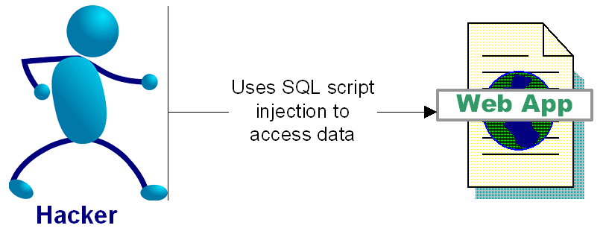
SQL Injection Attacks
“SQL injection is a security vulnerability that occurs in the database layer of an application. Its source is the incorrect escaping of dynamically-generated string literals embedded in SQL statements. “ (Wikipedia)

Slide 31
Impact of SQL Injection - Dangerous
At best: you can leak information
Depending on your configuration, a hacker can
  Delete, alter or create data
  Grant direct access to the hacker
  Escalate privileges and even take over the OS

Slide 32
SQL Injection Attacks
Login Example Attack
  Text in blue is your SQL code, Text in orange is the hacker input, black text is your application code
  Login: Password:
Dynamically Build SQL String performing authentication:
  “SELECT * FROM users WHERE login = ‘” + userName + “’ and password= ‘” + password + “’”;
Hacker logs in as: ‘ or ‘’ = ‘’; --
  SELECT * FROM users WHERE login = ‘’ or ‘’ = ‘’; --‘ and password=‘’

Slide 33
More Dangerous SQL Injection Attacks
Hacker creates a Windows Account:
  SELECT * FROM users WHERE login = ‘’; exec master..xp_cmdshell 'net users username password /add';--’ and password= ’’
And then adds himself as an administrator:
  SELECT * FROM users WHERE login = ‘'; exec master..xp_cmdshell 'net localgroup Administrators username /add';--’ and password= ‘’
SQL Injection examples are outlined in:
  http://www.spidynamics.com/papers/SQLInjectionWhitePaper.pdf
  http://www.unixwiz.net/techtips/sql-injection.html

Slide 34
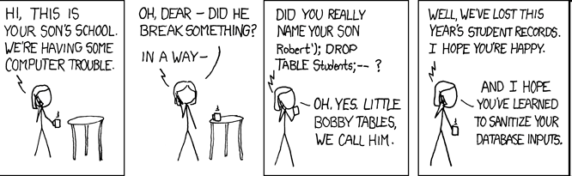
Exploits of a Mom
http://xkcd.com/327/

Slide 35
SQL Injection Demo…
String SQL Injection

Slide 36
Preventing SQL injection
Use Prepared Statements (aka Parameterized Queries)
  $id=1234
  “select * from accounts where id = “ + $id
  vs
  “select * from accounts where id =1234”
Validate input
  Strong typing
    If the id parameter is a number, try parsing it into an integer
  Business logic validation
Escape questionable characters (ticks, --, semi-colon, brackets, etc.)

Slide 37
Mimimize the Impact of SQL injection
Quiz: Is running a Web Application as the Database System Admin “sa” account a good practice?
Use the principle of least privilege
  If the query is reading the database, do not run the query as a user with update permissions (dbo, drop, etc)

Slide 38
Injection Impacts
More Than SQL
“Injection Flaw” is a blanket term
SQL Injection is most prevalent
Other forms:
  XPath Injection
  Command Injection
  LDAP (Lightweight Directory Access Protocol) Injection
  DOM (Document Object Model) Injection
  JSON (Javascript Object Notation) Injection
  Log Spoofing
  On and on and on…

Slide 39
This Presentation's Re-ordered
Top 10 List
Cross-Site Scripting (XSS)
Cross-Site Request Forgery (CSRF)
Insecure Direct Object Reference
Injection Flaws
    SQL Injection, XPATH Injection, etc
Broken Authentication and Session Management
Failure to Restrict URL Access
Insecure Cryptographic Storage

Slide 40
Authentication Checks
From http://www.owasp.org/index.php/Top_10_2010-Main “Account credentials and session tokens are often not properly protected. Attackers compromise passwords, keys, or authentication tokens to assume other users' identities.”
Never store passwords in plaintext
  Encrypt or Hash+Salt (preferred)
Architect applications to check every request to see that the authentication data is still valid
Issue a new session token when a change in privilege occurs
  ASP reuses session IDs by default!
If you absolutely must use “remember me” functionality, use a difficult to guess authentication cookie
Authentication data is sent with every request, so protect it

Slide 41
Session Attacks
Session Fixation: The hacker predicts a valid session key (usually via phishing)
Session Hijacking: The hacker masquerades as another user by stealing the users session id (usually via XSS)

Slide 42
Demos
Spoofing an Authentication Cookie

Slide 43
Hardening Authentication
Every request to each page of a web application should be revalidated for proper authenticated and authorized access
Check validity of authentication cookie on each request. Validate original IP address is the same as current request IP and age since created or last checked. Deny access if not.
Check that the authenticated user is authorized to access your application (using internal database of users, LDAP, authorization service, etc) on each request

Slide 44
Solution
Use built in session management!
  Most application servers do a pretty good job of this (except ASP, boo Microsoft)
Use secure randomly generated session keys to make prediction impossible
  Don’t expose the user to session ids if possible
Use reasonable session timeouts

Slide 45
This Presentation's Re-ordered
Top 10 List
Cross-Site Scripting (XSS)
Cross-Site Request Forgery (CSRF)
Insecure Direct Object Reference
Injection Flaws
    SQL Injection, XPATH Injection, etc
Broken Authentication and Session Management
Failure to Restrict URL Access
Insecure Cryptographic Storage

Slide 46
Failure to Restrict URL Access
“Frequently, an application only protects sensitive functionality by preventing the display of links or URLs to unauthorized users. Attackers can use this weakness to access and perform unauthorized operations by accessing those URLs directly. “
Can be caused by:
  Improper authentication
  Incorrect authorization
  Unprotected admin areas
    Usually caused by easy to guess URLs
.htaccess is your friend!

Slide 47
This Presentation's Re-ordered
Top 10 List
Cross-Site Scripting (XSS)
Cross-Site Request Forgery (CSRF)
Insecure Direct Object Reference
Injection Flaws
    SQL Injection, XPATH Injection, etc
Broken Authentication and Session Management
Failure to Restrict URL Access
Insecure Cryptographic Storage

Slide 48
Insecure Cryptographic Storage
From http://www.owasp.org/index.php/Top_10_2007 : “Web applications rarely use cryptographic functions properly to protect data and credentials. Attackers use weakly protected data to conduct identity theft and other crimes, such as credit card fraud.”
Use latest standard encryption methods
  They are standards for a reason! And they change over time
Use strong standard encryption methods
  Stop using Message-Digest Algorithm 5 (MD5), Secure Hash Algorithm (SHA1), Data Encryption Standard (DES)
  Use SHA-256, Advanced Encryption Standard (AES), Rivest/Shamir/Adleman Public Key Encryption (RSA)
Encrypt stored passwords with above methods

Slide 49
“MD5 Considered Harmful Today”
MD5 has been known to have serious weaknesses which produce collisions
It has been considered a weak hash function since at least 2004
Using knowledge of MD5 collisions, researchers were able to impersonate a root CA common to all browsers
This rogue CA can issue SSL certificates that even the knowledgeable end user may not notice
http://www.win.tue.nl/hashclash/rogue-ca/

Slide 50
Thanks for coming!
Notes:
WIFI Example
"/><object width="480" height="385"><param name="movie" value="http://www.youtube.com/v/oHg5SJYRHA0&hl=en_US&fs=1&"></param><param name="allowFullScreen" value="true"></param><param name="allowscriptaccess" value="always"></param><embed src="http://www.youtube.com/v/oHg5SJYRHA0&autoplay=1" type="application/x-shockwave-flash" allowscriptaccess="always" allowfullscreen="true" width="480" height="385"></embed></object><font color="black">@gmail.com

